Slide 1
Random & Obscure Crash Course
A quick guide to what you might not know or what you’re still confused about.

Slide 2
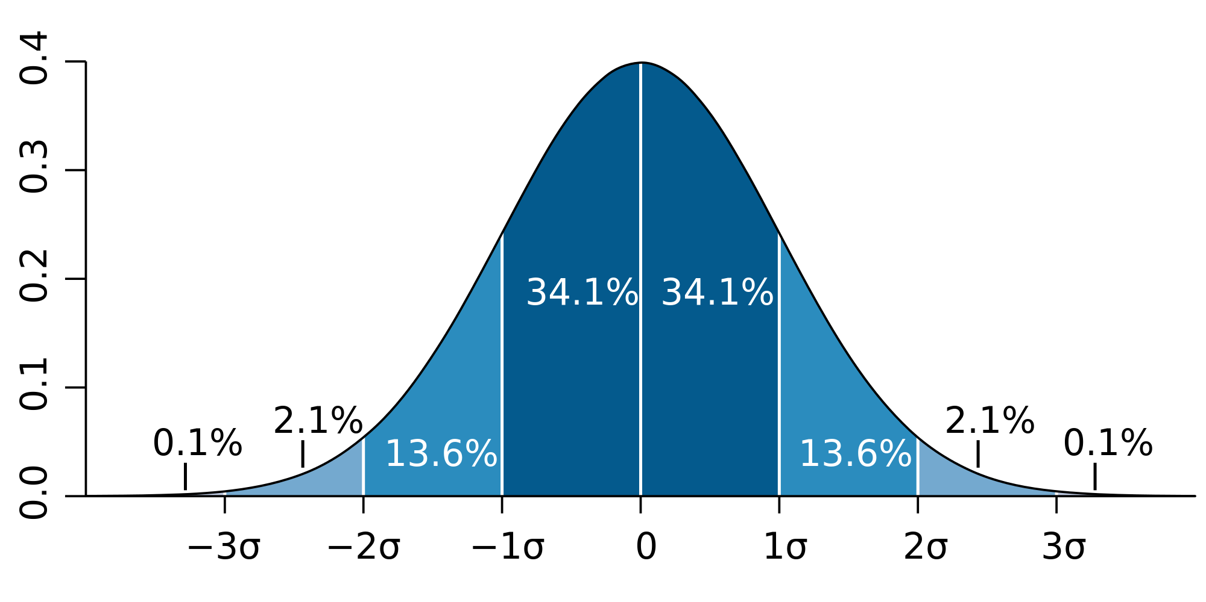
Standard Deviation

Slide 3
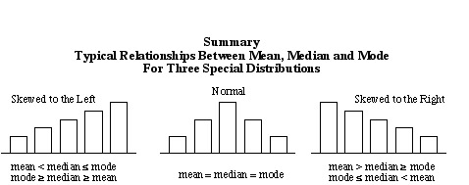
Measures of Central Tendency

Slide 4
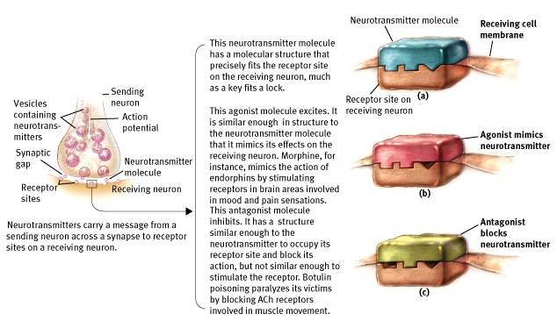
Agonists and Antagonists
Notes:
Agonists - drugs that mimic or copy neurotransmitters, make it MORE likely the next neuron will fire. Fit into receptor cells.
Antagonists - drugs that BLOCK neurotransmitters. Fill the receptor sites on the dendrites. Prevent the *real* neurotransmitter from working.

Slide 5
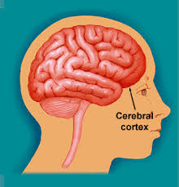
Cerebral Cortex
The cerebral cortex makes up the FRONTAL, PARIETAL, OCCIPITAL, and TEMPORAL LOBE
Prefrontal Cortex - newest area of brain responsible for higher level thinking, planning, judgement
You know the lobes...but should know they all make up the cerebral cortex

Slide 6
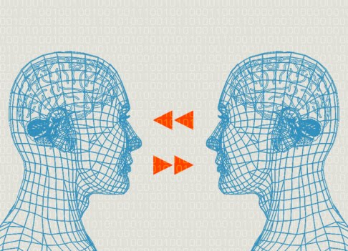
Mirror Neurons
Neurons in the premotor cortex
Empathy
Mimic
Observational Learning

Slide 7
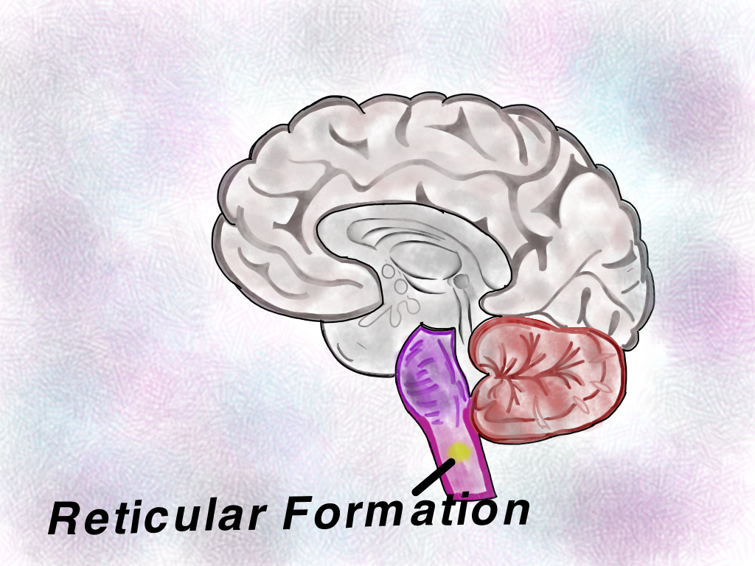
Reticular Formation
Reticular Activating System
R.A.S. = Rise and Shine
Arousal
Attention
SAME TERM

Slide 8
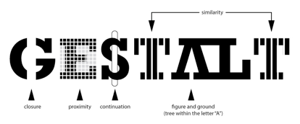
Closure - closing up the spaces
Symmetry - similar parts face each other
Proximity - close things must be together
Continuity - things continue in a fluid line (even if blocked)
Figure Ground (black space/white space)
Similarity - things that are alike are together

Slide 9
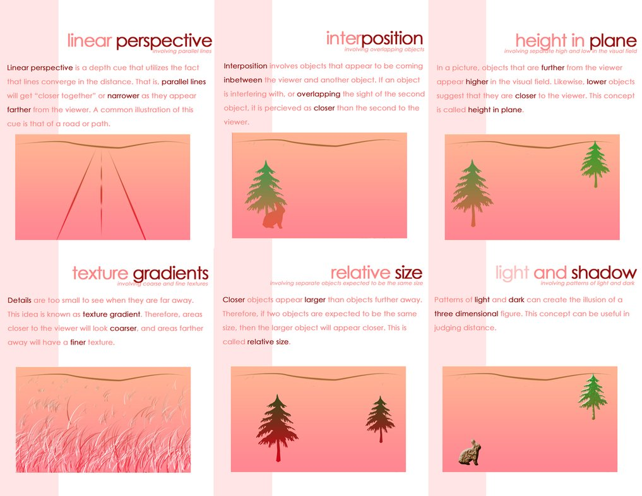
Notes:
Motion parallax, Height in plane = relative height

Slide 10
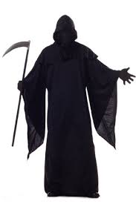
Elizabeth Kubler-Ross
The stages of death and dying
Denial
Anger
Bargaining
Depression
Acceptance
Not scientifically valid, but interesting

Slide 11
Heritable
The extent to which THE DIFFERENCE among individuals can be attributed to genes.
Highly heritable = Height, IQ
Lower heritability = skin cancer, type 2 diabetes
Fun Fact: Having two eyes has 0 heritability. Essentially, everyone is born with two eyes.

Slide 12
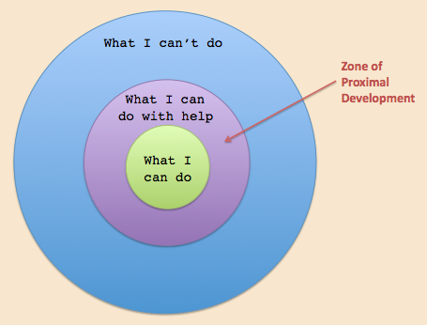
Lev Vygotsky
Culture influences development, cognitive development
The ZONE OF PROXIMAL DEVELOPMENT
Scaffolding
What you can accomplish with the help of a more experienced person

Slide 13
Gender
Sex
XX (girl) or XY (boy)
Biological
Gender
Social Learning Theory
How we learn gender from our society
Gender Roles - expectations for being male or female
Gender Schema Theory
How we think about gender

Slide 14
Feature Detectors
Torsten & Hubel (Nobel in 1981)
Shapes, Angles, and Movements (SAM)
Neurons in visual cortex
We use these to parallel process
Sensing many different things happen at once
We also parallel process music

Slide 15
Memory
Three-Box Model aka Atkinson and Shiffrin Model aka Information Processing Model
Sensory
Short-term (working memory)
Long Term Memory
NOTE: THIS IS NOT ENCODING, STORAGE, RETRIEVAL

Slide 16
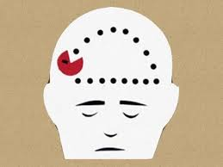
Psychogenic Amnesia
You forget something
No physical or biological reason
Also…
Dissociative amnesia
Anterograde amnesia
Retrograde amnesia
Infantile amnesia

Slide 17
Memory
Long Term Memories
Declarative/Explicit
Semantic Memory - general facts, not personal
Episodic - personal, biographical events
Prospective Memory - memory for a future event
Implicit/Non-declarative
Procedural - how to do something
Emotional Memories
Flashbulb Memories

Slide 18
Instinctive Drift
Rewards? Who cares?
With animals, sometimes a reinforcement can not get them to perform a behavior that is counter-instinctive to their nature
A rat won’t walk backwards.
A pig can’t be trained to put a coin in a bank. They bury them.

Slide 19
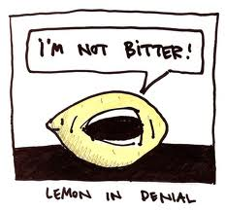
Defense Mechanisms
Repression
Regression
Sublimation
Denial
Reaction Formation
Displacement
Projection
Rationalization

Slide 20
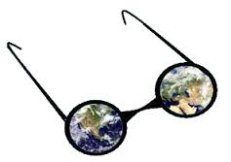
Personal Construct Theory
George Kelly
We create our own view of the world, what is right-wrong, fair-unfair
How do you interpret your world?
Personality/Development idea

Slide 22
Types of Psychology
Human Factors Psychology
design products, equipment and systems for maximum safe, effective, satisfying use by humans
Industrial-Organizational Psychology (I/O)
How psychology can be applied to the study of human behavior in the work place
Motivation, employee morale, etc...

Slide 23
Omission Training
Operant Conditioning
UNPLEASANT CONSEQUENCES
STOPS unwanted behavior
Also known as punishment
Positive and Negative

Slide 24
Second-Order Conditioning
Also known as “Higher Order” conditioning
We can sometimes classically condition people using the CS
If a person is trained to salivate to a bell, you may be able to substitute a blue light for the bell and still get the conditioned response

Slide 25
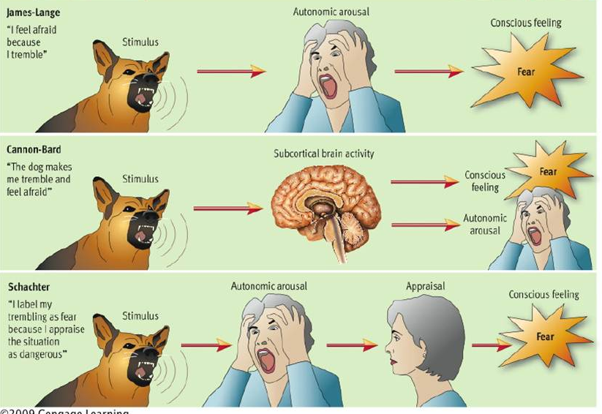
Notes:
Theories of Emotion
JL - Jump & Label
CB - Cymbols bash at the SAME TIME
SS2F - what you think about the physical arousal

Slide 26
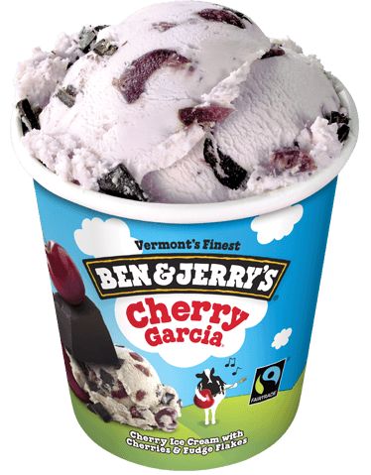
Taste Aversion
John Garcia
Garcia Effect
We avoid food or drink that’s made us ill
We’re BIOLOGICALLY predisposed to do this
Strange taste + sickness = avoid
Doesn’t need repeating. 1x is enough

Slide 27
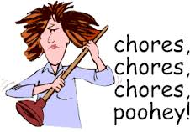
Premack Principle
You can operantly condition someone to do something they don’t like by providing an incentive they do.
Want the car?

Slide 28
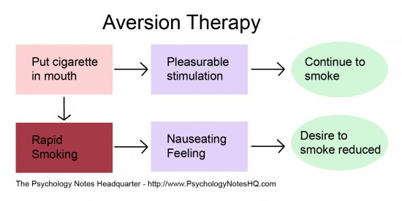
Aversive Conditioning
Pairs a habit (smoking) with something unpleasant (nausea) to stop the behavior.
Aversive = means sucky

Slide 29
Robert Rescorla
Cognition can mess with classical conditioning
Contingency Theory
In CC, an organism can predict the likelihood of a certain event occurring

Slide 30
Hypnosis Theories
Role Theory
Theorize that hypnosis is not an alternate state of consciousness at all. People who are easily hypnotized have richer fantasy lives and follow directions well.
State Theory
Hypnosis meets some parts of the definitions for an altered state of consciousness.
Divided Consciousness - Hypnosis involves dissociation, a split in consciousness in which one part of the mind operates independently of the rest of consciousness.
Hidden observer
Ernst Hilgard

Slide 31
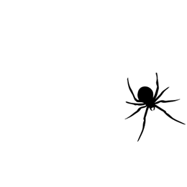
Systematic Desensitization
Therapy
Relaxation
Create anxiety hierarchy (ranking of fear)
Behavior Therapy
Phobias
Joseph Wolpe
Little Peter/Mary Cover Jones study

Slide 32
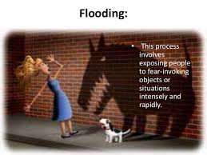

Slide 33
Deep Structure vs. Surface Structure
Surface Structure of Language vs. what the sentence means
Examples:
POLICE BEGIN CAMPAIGN TO RUN DOWN JAYWALKERS
FARMER BILL DIES IN HOUSE
LUNG CANCER IN WOMEN MUSHROOMS
TEACHER STRIKES IDLE KIDS

Slide 34
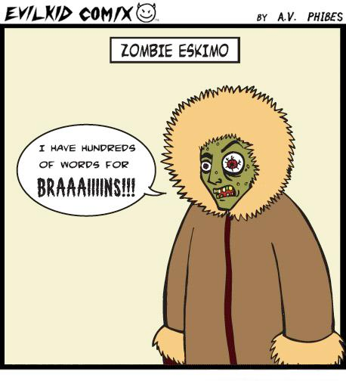
Linguistic Relativity
Whorf-Sapir Hypothesis
Whorf Hypothesis
Linguistic Determinism
Languages we use control and limits our thinking
Definitely influences it

Slide 35
Language Acquisition Device
Noam Chomsky
Language in innate
We have a LAD...an innate ability to learn language
Evidence: most people learn language in recognizable steps
We learn language so easily is must be inborn
a.k.a. - Nativist Theory of Language Acquisition

Slide 36
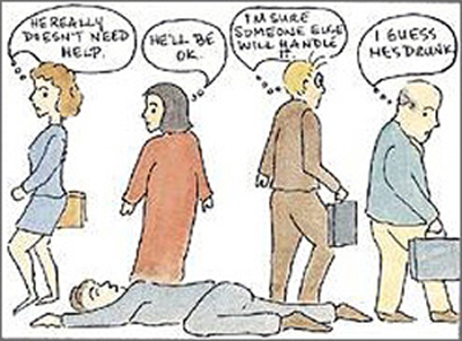
“Diffusion of Responsibility”
A tricky term that is just referring to the bystander effect
Kitty Genovese
John Darley and Bibb Latane

Slide 37
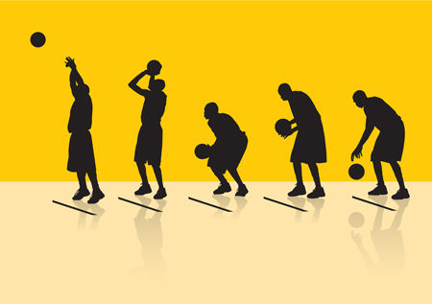
Social Impairment
When you’re watched by others it hurts performance on a task
OPPOSITE of Social Facilitation
Likely some connection to Yerkes-Dodson

Slide 38
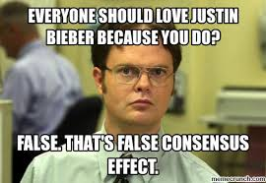
False Consensus Effect
Overestimating how similarly other people think like you
Social Psychology
Surveys

Slide 39
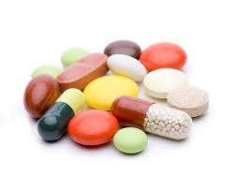
Neuroleptics
Psychopharmacology - using drugs to treat mental illness
Tardive dyskinesia
Antipsychotic drugs used to treat schizophrenia
Thorazine
Clozapine
Haloperidol

